Slide 1




HACKATHON
TEAM NAME:
TEAM LEADER NAME:
INSTITUTION :
PROBLEM STATEMENT:

Slide 2
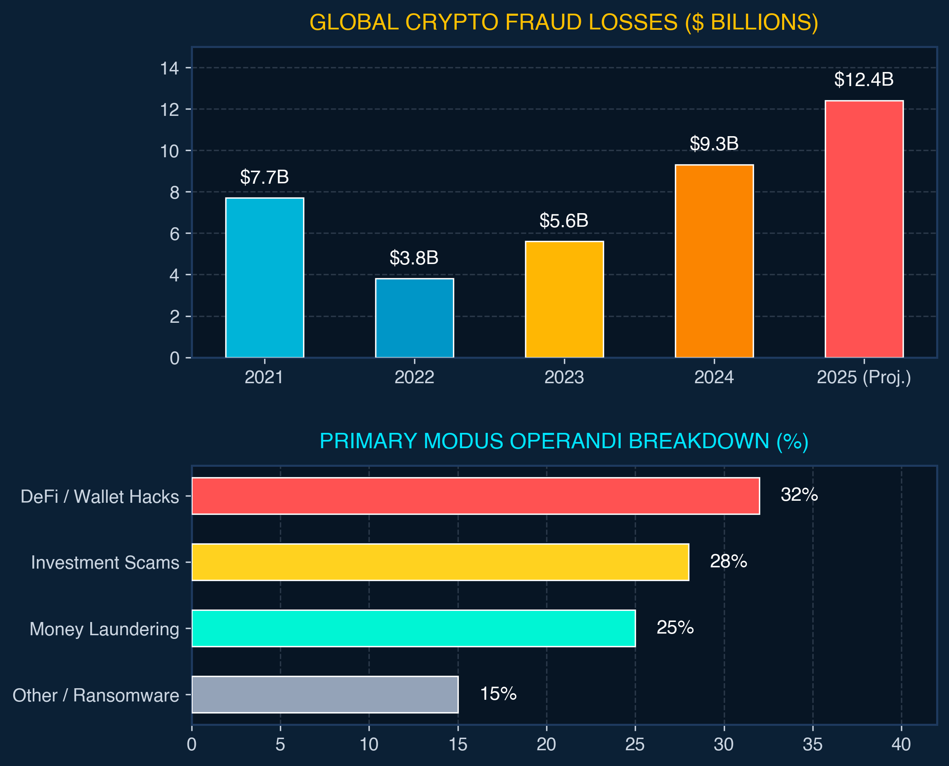
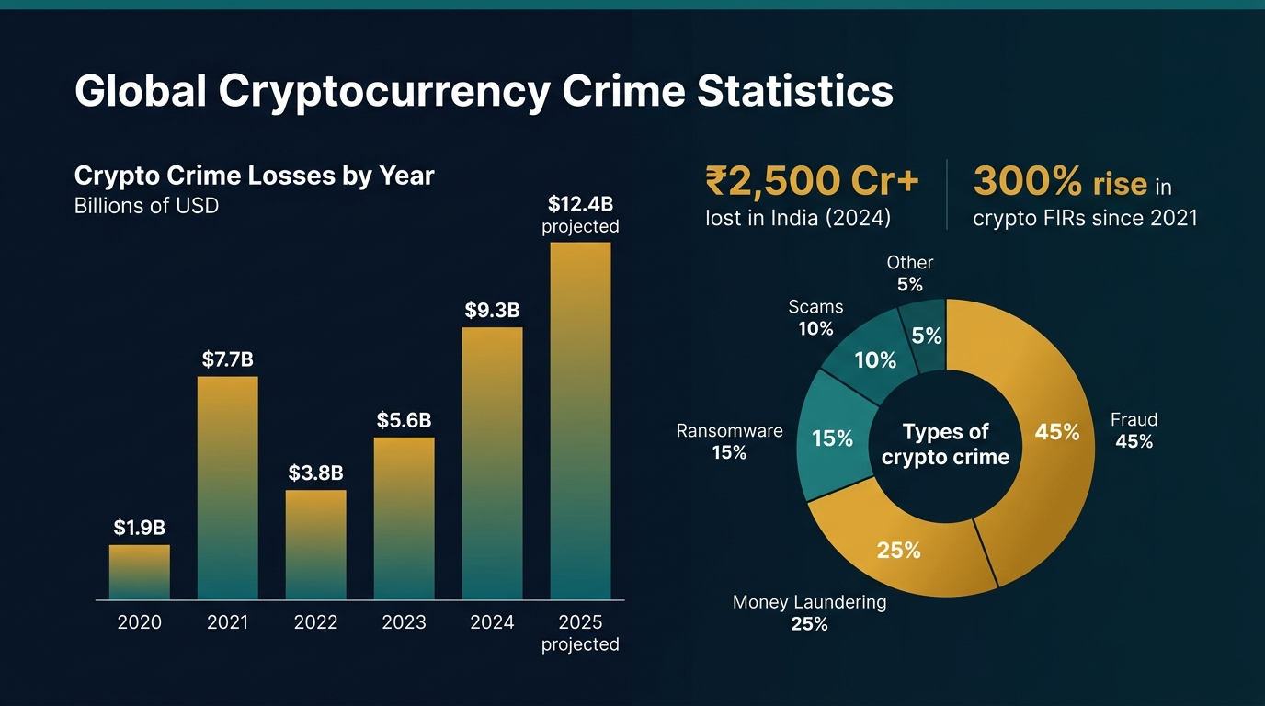
Problem Statement
🚨 THE CRIME CRISIS
₹2,500+ Cr
Lost to Crypto Frauds in India (2024)
• 300%+ surge in cybercrime FIRs involving crypto since 2021.
• Illicit funds vanish through mixers & cross-chain bridges in <10 mins.
🎯 CURRENT & UPCOMING MARKET ROLE
• Current Market Need: Slashes 14-day manual tracing to minutes, enabling real-time freeze notices to exchanges.
• Upcoming Market: Pan-India intelligence backbone to counter AI-automated fraud and cross-chain syndicates.
• Mission: Turn passive complaint logs into proactive asset recoveries.
Chandigarh Police Hackathon 2026

Slide 3
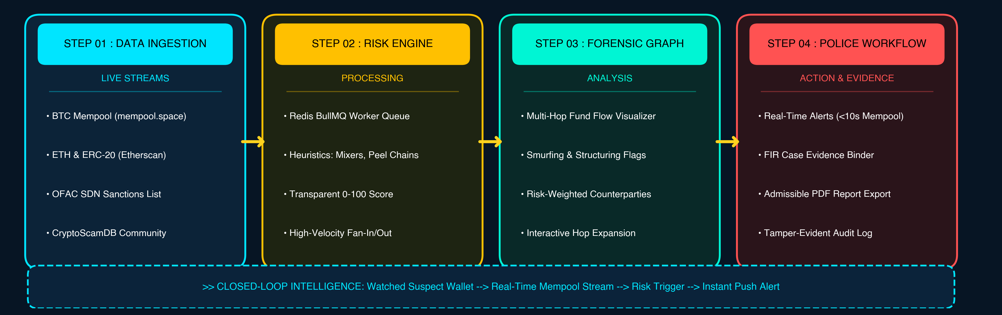
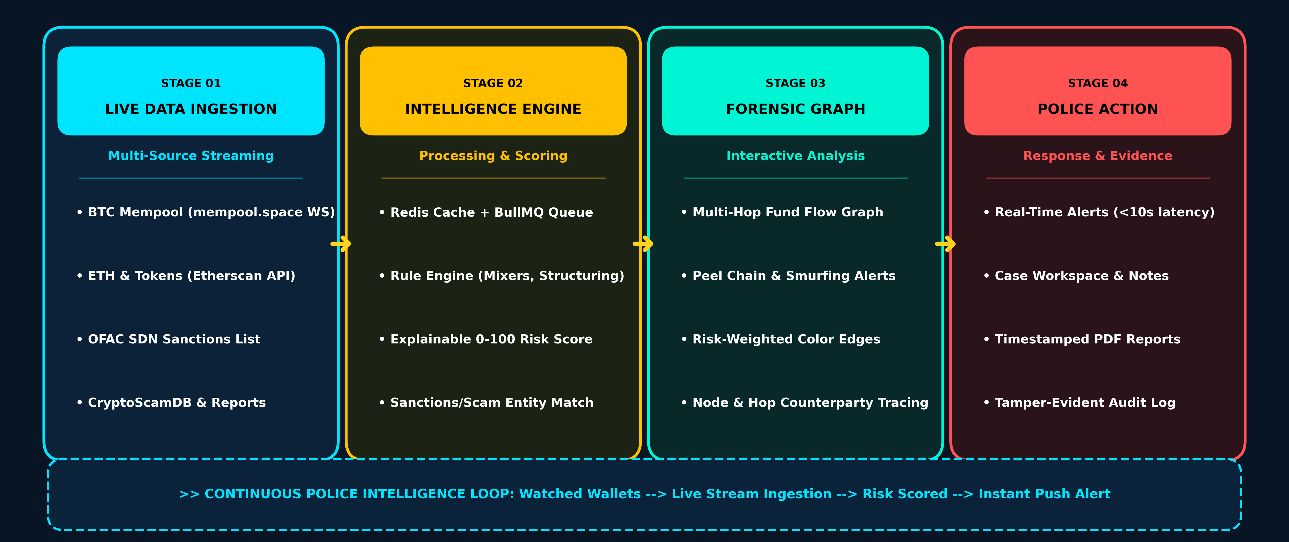
Proposed Solution
⚡ 01. LIVE INGESTION
Live BTC mempool & ETH block streaming + OFAC sanctions sync
🧠 02. RISK ENGINE
Explainable 0–100 risk scoring with transparent rule heuristics
🕸️ 03. FORENSIC GRAPH
Multi-hop fund-flow graph tracing peel chains & mixer hops
⚖️ 04. POLICE ACTION
Sub-10s live alerts, FIR case binders & 1-click court PDF reports
Chandigarh Police Hackathon 2026

Slide 4
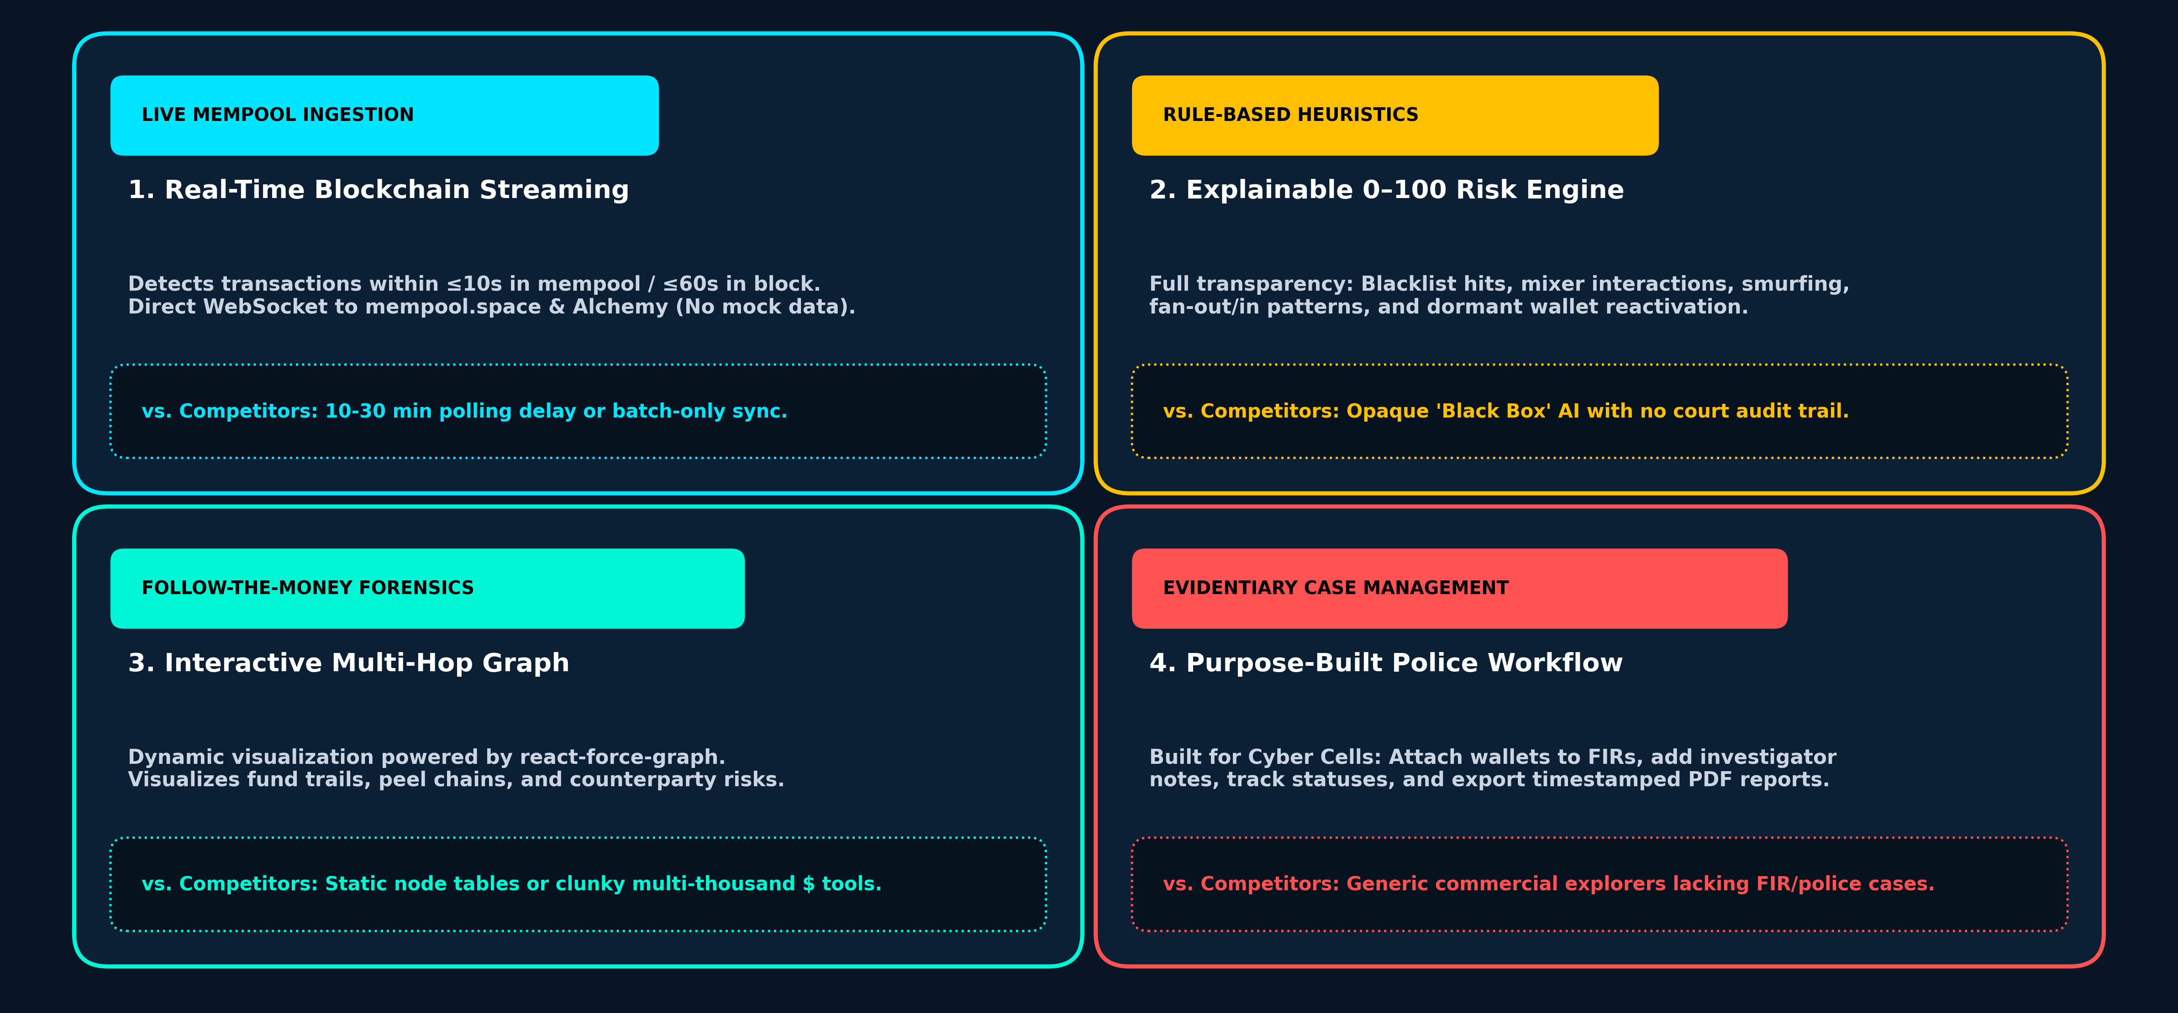
KEY FEATURES
[REAL-TIME STREAMING]
1. 100% Real Live-Chain Ingestion
• Direct WebSocket to mempool.space & Alchemy (detection in ≤10s). • Zero mock data; connects to live public Bitcoin & Ethereum ledgers.
★ vs. Competitors: 15–30 min polling delays or expensive private nodes.
[EXPLAINABLE FORENSICS]
2. Explainable 0–100 Risk Engine
• Transparent heuristics: OFAC blacklist hits, mixers, and fan-out/in. • Populates detailed evidence reasons for every flagged transaction.
★ vs. Competitors: Opaque 'black box' AI with zero court audit trail.
[GRAPH VISUALIZATION]
3. Interactive Multi-Hop Fund Graph
• Dynamic follow-the-money graph powered by react-force-graph. • Pinpoints structuring (smurfing), peel chains, and counterparty clusters.
★ vs. Competitors: Generic explorers show flat lists; tools cost $50k+/yr.
[LAW ENFORCEMENT WORKFLOW]
4. Police Case Workspace & PDF Export
• Purpose-built for Cyber Cells: Attach suspect wallets to FIR numbers. • Generates timestamped, court-ready PDF evidence reports in 1-click.
★ vs. Competitors: Commercial compliance tools lack police case workflows.
Chandigarh Police Hackathon 2026

Slide 5
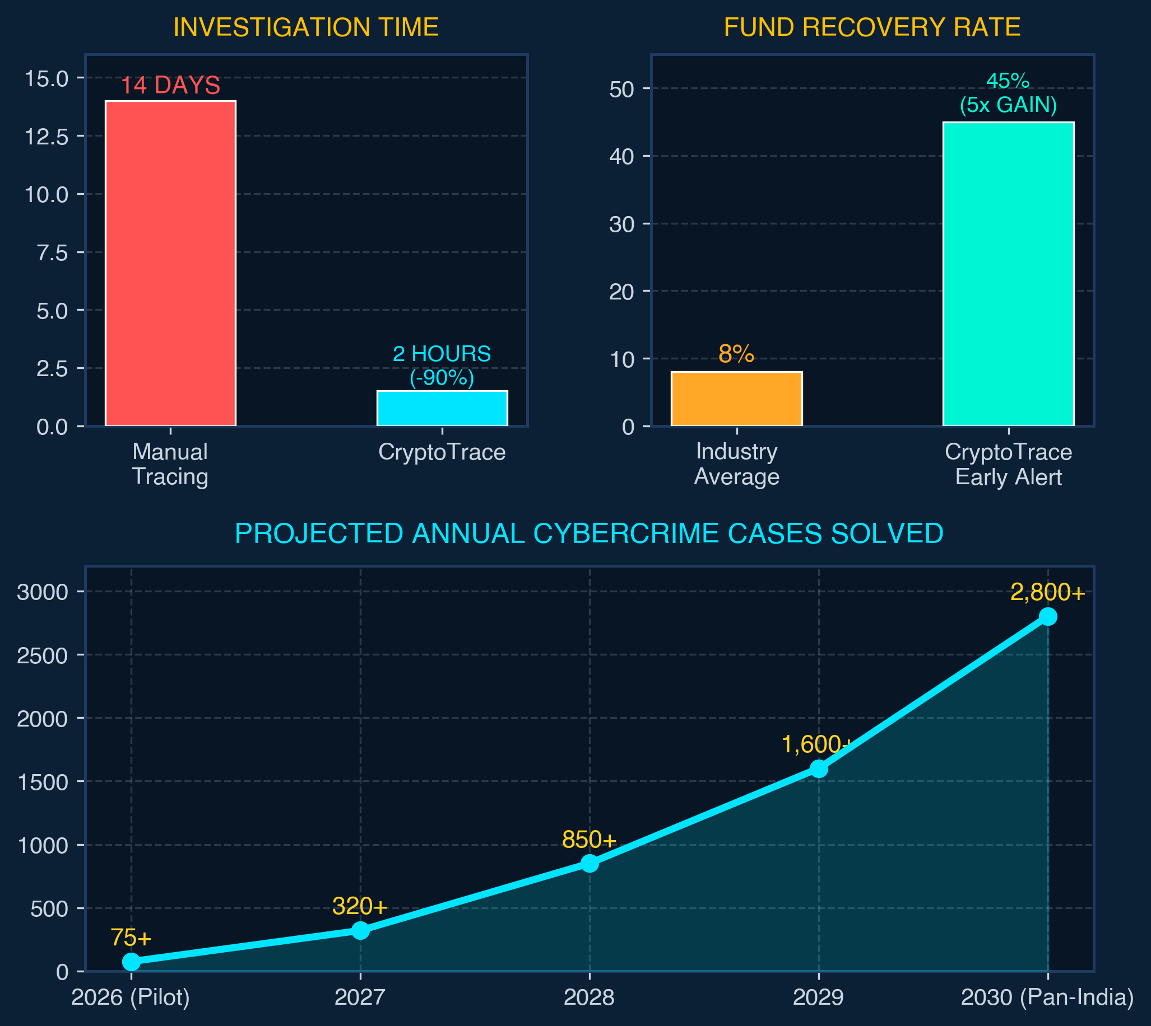
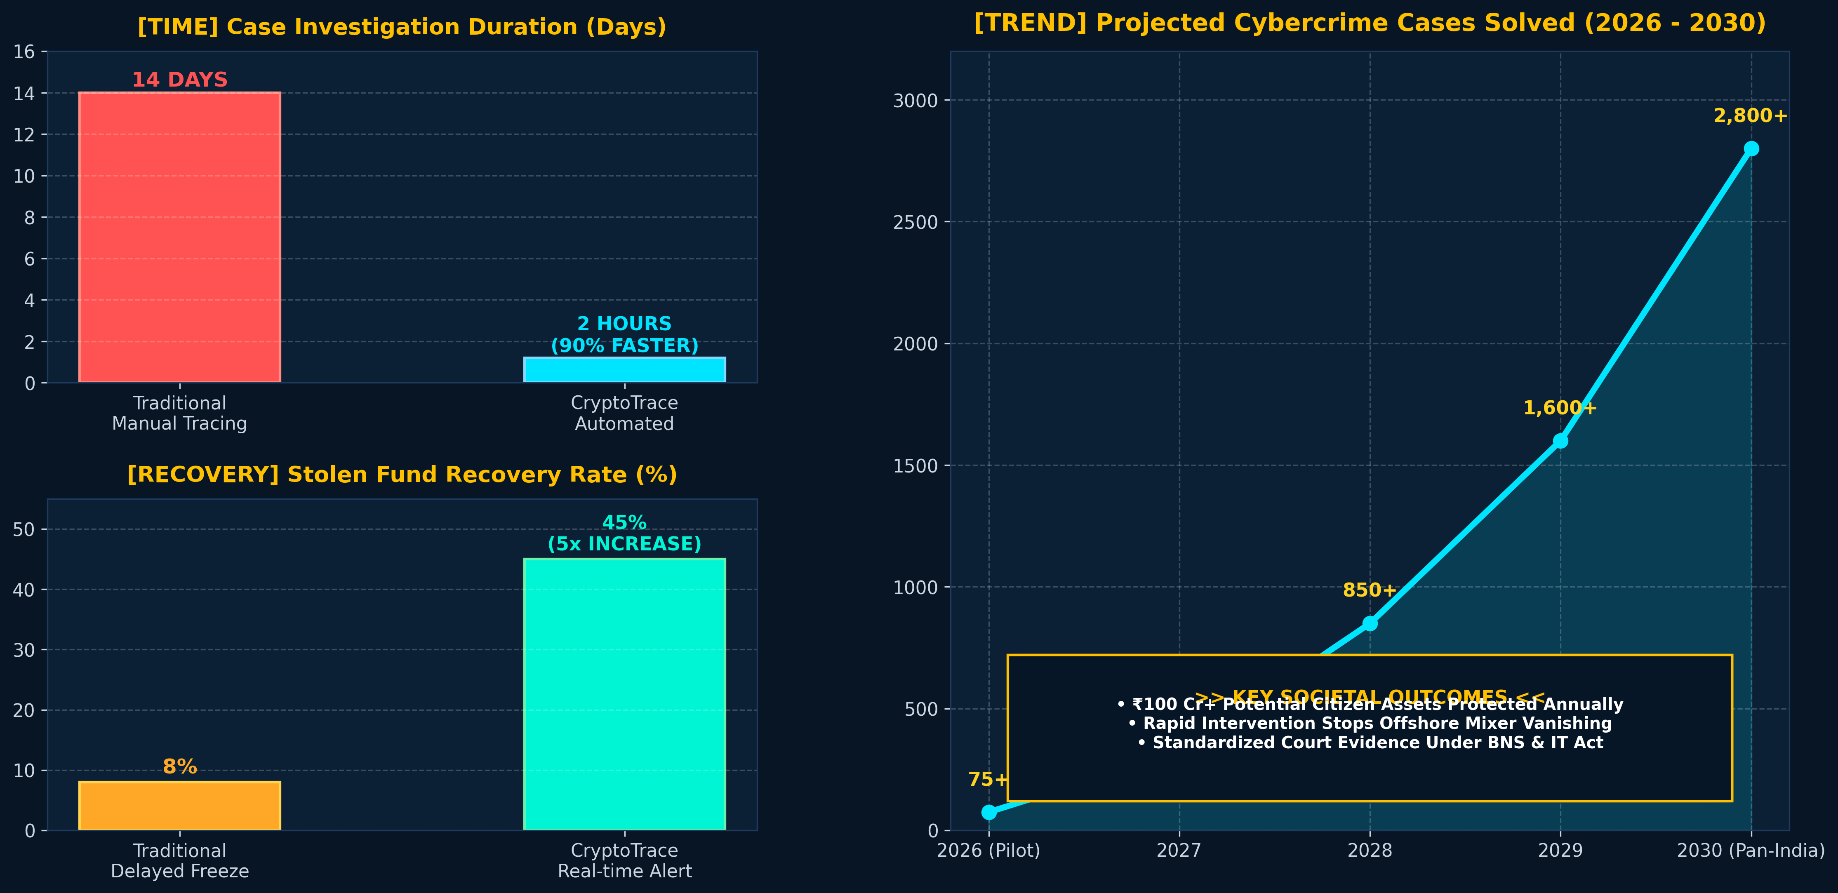
DELIVERABLES / PROPOSED OUTCOME
⚡ 90% FASTER INVESTIGATIONS
• Slashes fund-tracing cycle from 14 days to under 2 hours.
• Enables immediate freeze notices to exchanges before cash out.
💰 5x HIGHER ASSET RECOVERY
• Real-time mempool alerts intercept money laundering at Stage-1.
• Prevents total loss of citizen savings to mixers and offshore bridges.
🛡️ EMPOWERING LAW ENFORCEMENT
• Equips state & local cyber units without expensive proprietary licenses.
• Timestamped PDF audit reports admissible under BNSS & IT Act.
Chandigarh Police Hackathon 2026

Slide 6
PROTOTYPE
(IMG OR VID IF ANY)
Chandigarh Police Hackathon 2026

Slide 7
THANK YOU

